Slide 1
Chapter 1
1.1 Introduction
1.2 Computer hardware review
1.3 Operating system concepts

Slide 2
1.1 Introduction
What is an operating system
History of operating systems
The operating system zoo

Slide 3
What is an operating system

Slide 4
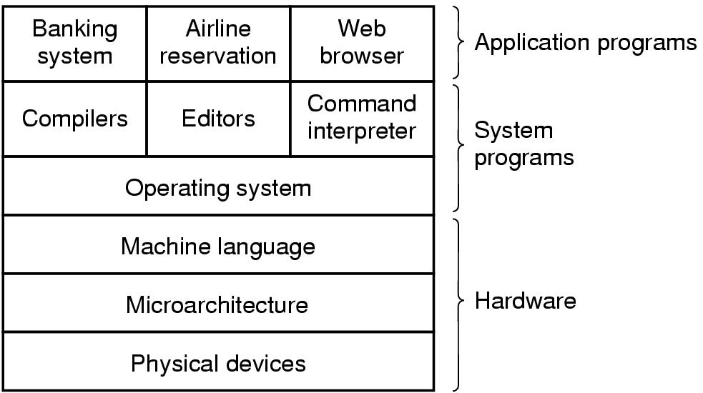
Computer system
A computer system consists of
hardware
system programs
application programs

Slide 5

What is an Operating System
A program that acts as an intermediary between a user of a computer and the computer hardware
user 1
user 2
user 3
user N
System/application programs
word
processor
spreadsheets
compilers
Web
browsers
Operating system
Hardware

Slide 6
What is an Operating System
How can I do if there is no Operating system?
user 1
user 2
user 3
user N
System/application programs
word
processor
spreadsheets
compilers
Web
browsers
Hardware
Notes:
What happens if a computer doesn't have an operating system? Why?

Slide 7

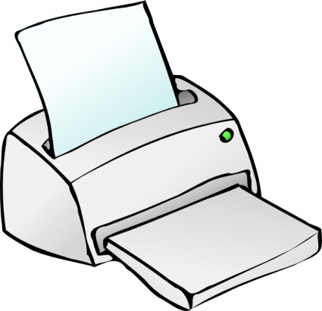

What is an Operating System
Operating systems are huge, complex, and long-lived
They include at least five million lines of code or more
50 lines/page
1000 pages/book
100 books
Images: clipart-library.com

Slide 8
What is an Operating System
Window: 70 million lines of code (exclude Internet Explorer, Window Media Player)
50 lines/page
1000 pages/book
Images: clipart-library.com
10 - 20 bookcases

Slide 9
What is an Operating System
OS is an extended machine
Hides the messy details which must be performed
Presents user with a virtual machine, easier to use
OS is a resource manager
Each program gets time with the resource
Each program gets space on the resource

Slide 10
History of Operating Systems

Slide 11
History of Operating Systems
First generation 1945 - 1955
vacuum tubes, plug boards
Second generation 1955 - 1965
transistors, batch systems
Third generation 1965 – 1980
ICs and multiprogramming
Fourth generation 1980 – present
personal computers

Slide 12
History of Operating Systems First generation 1945 - 1955
Computers:ENIAC, UNIVAC…
Operating System: No OS,
Machine Language, plugboards
Single group: designed, built, programmed, operated and maintained each machine

Slide 13
History of Operating Systems Second Generation 1955 – 1965 (1)
Computers: IBM 1401, IBM 7094…
Operating System : FMS (Fortran Monitor System), IBSYS for Computer 7094
Batch Systems
Function of Early Batch System
Structure of a typical FMS job
Separation between designers, builders, programmers, operators and maintenance personnel

Slide 14
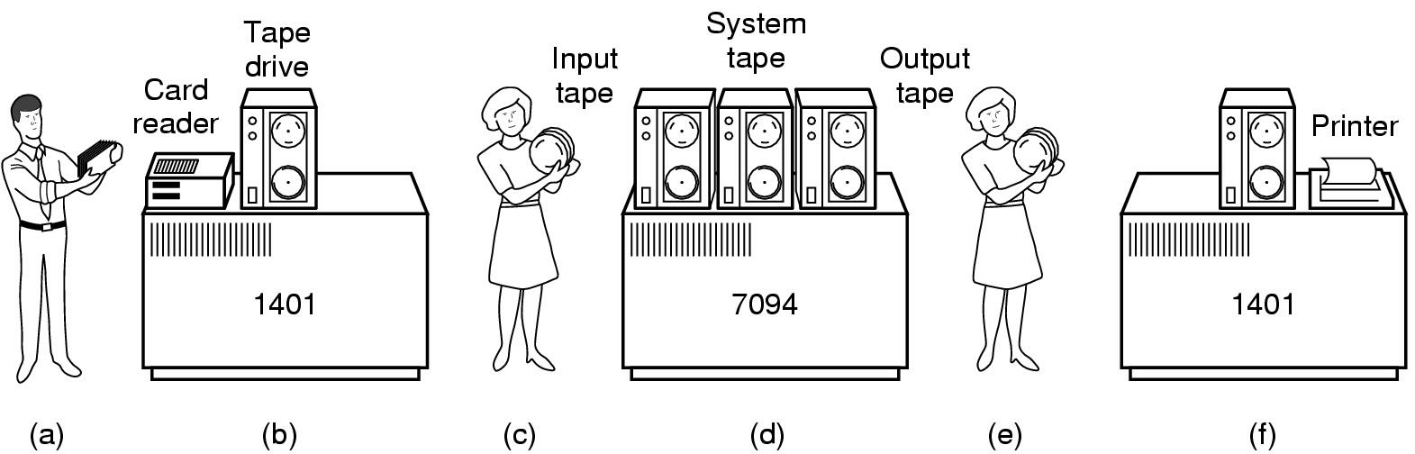
History of Operating Systems Second Generation 1955 – 1965 (2)
Early batch system
bring cards to 1401
read cards to tape
put tape on 7094 which does computing
put tape on 1401 which prints output

Slide 15
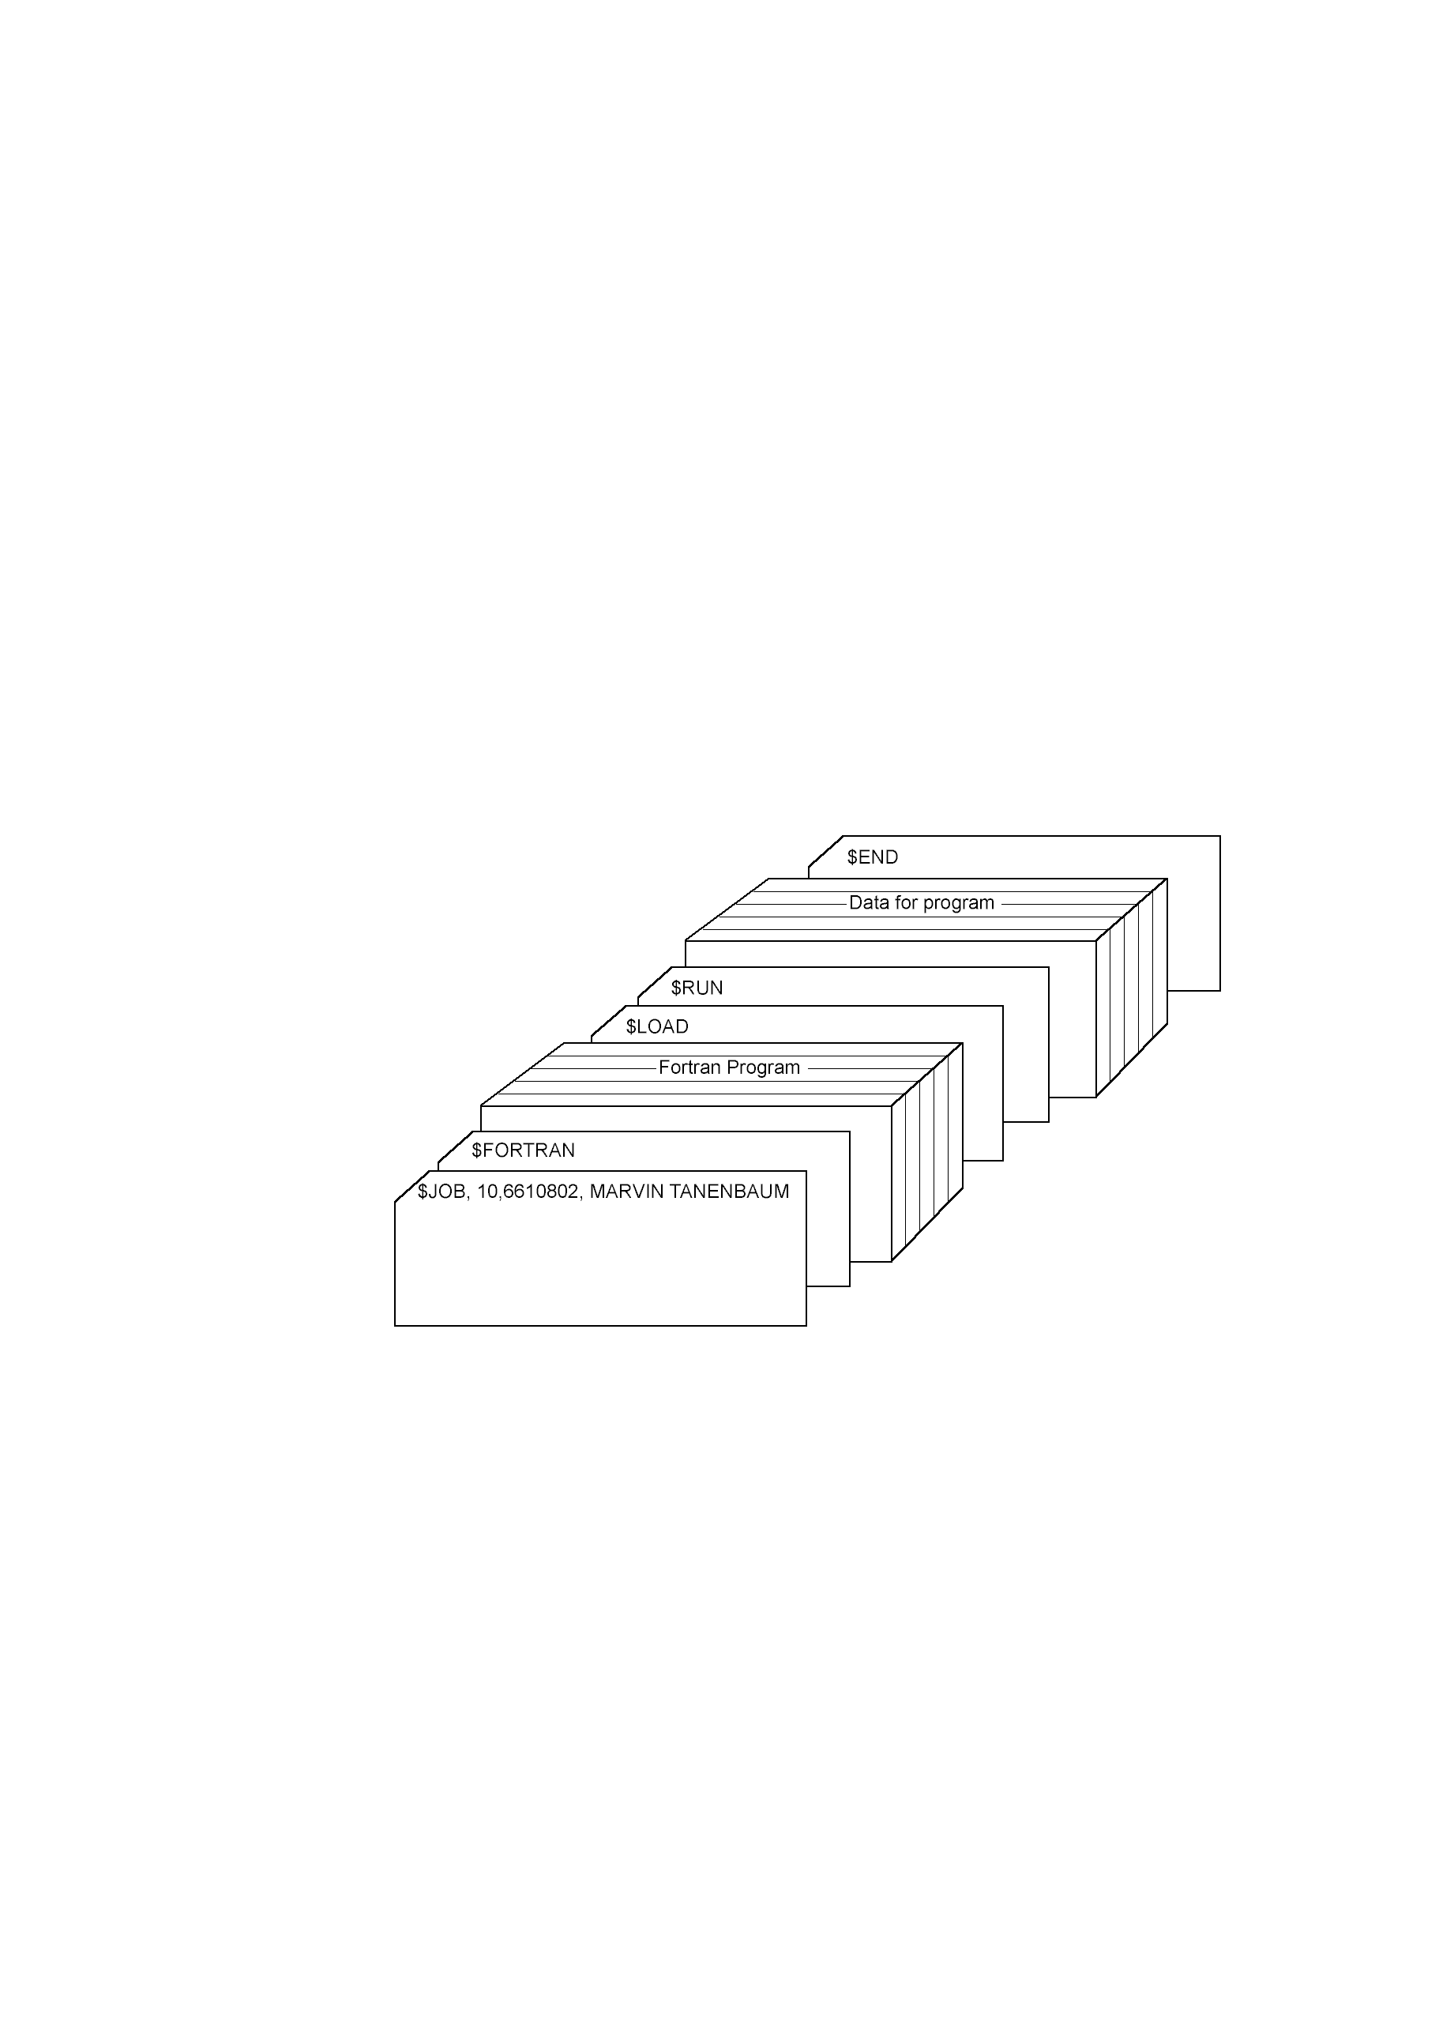
History of Operating Systems Second Generation 1955 – 1965 (3)
Structure of a typical FMS job – 2nd generation

Slide 16
History of Operating Systems Third generation 1965 – 1980 (1)
Computers: System/360, IBM370, IBM4300…
Operating System:
OS/360: to work on all models
Multiprogamming
Time Sharing:
CTSS (Compatible Time Sharing System),
MULTICS (MULTiplexed Information and Computing Service),
Unix

Slide 17
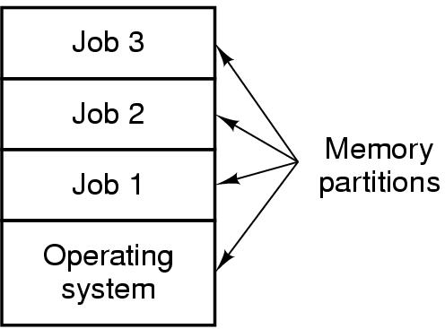
History of Operating Systems Third generation 1965 – 1980 (2)
Multiprogramming system
three jobs in memory – 3rd generation

Slide 18
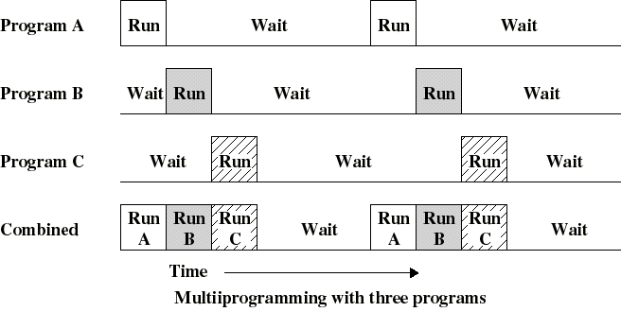
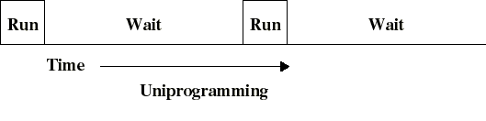
History of Operating Systems Third generation 1965 – 1980 (3)

Slide 19
History of Operating Systems Fourth generation 1980 – present
Computers: IBM PC 80x86, Macintosh…
Operating System:
1977: CP/M (Control Program for Microcomputer)
1980: DOS (Disk Operating System)
GUI with Macintosh
1985-1995: Window 3.x
1995: Window 95
1996: Window NT 4.0
1999: Window 2000
Window 2003
Unix

Slide 20
The Operating System Zoo

Slide 21
The Operating System Zoo
Mainframe operating systems
Server operating systems
Multiprocessor operating systems
Personal computer operating systems
Real-time operating systems
Embedded operating systems
Smart card operating systems

Slide 22
The Operating System Zoo Mainframe operating systems
batch
multiprogrammed
time-sharing, multitasking
Application: High-End Web Server, Servers for Business-To-Business transactions
Example: OS/390

Slide 23
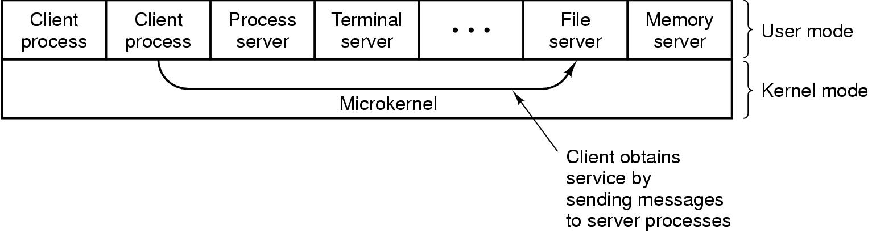
The Operating System Zoo Server operating systems

Slide 24
The Operating System Zoo Multiprocessor operating systems
Multiple CPU
Share computer bus, clock
Advantage:
High system throughput
High availability
Multiprocessor system and Multicomputer system

Slide 25
The Operating System Zoo Personal computer operating systems
Many I/O devices
Interface to single user
Many OS (MS Windows, Mac OS, Solaris, Linux,...).

Slide 26
The Operating System Zoo Real-time operating systems
Time is a key parameter
Two types of real-time system
Hard real-time system for industrial process control system…
Soft real-time system for multimedia system

Slide 27
The Operating System Zoo Embedded operating systems
Personal digital assistant (PDA): Palm, Pocket-PC, Cellular phones), control devices
Restriction of memory size, speed of CPU,
screen size, powers
Operating System: PalmOS, Windows CE (Consumer Electronic)

Slide 28
The Operating System Zoo Smart card operating systems
CPU chips on Card
Server processing power and memory constraint
Specific Application:
Single function: electronic payments
Multiple function: proprietary systems
Java oriented: holds interpreter JVM

Slide 29
1.2 Computer Hardware Review
- CPU
- Memory
- I/O Devices
- Buses

Slide 30
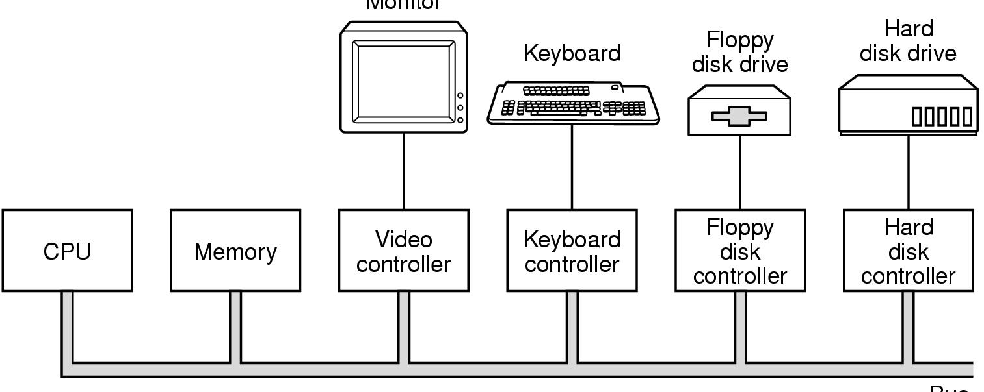
Computer Hardware Review
Monitor
Bus
Components of a simple personal computer

Slide 31
Computer Hardware Review The CPU (1)
PC Program Counter
SP Stack Pointer
PSW Program Status Word
General Registers
Instruction Cycle
Pipeline
Superscalar
System Call

Slide 32
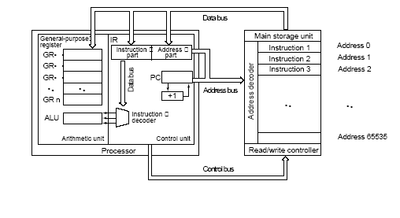
Computer Hardware Review The CPU (2)

Slide 33
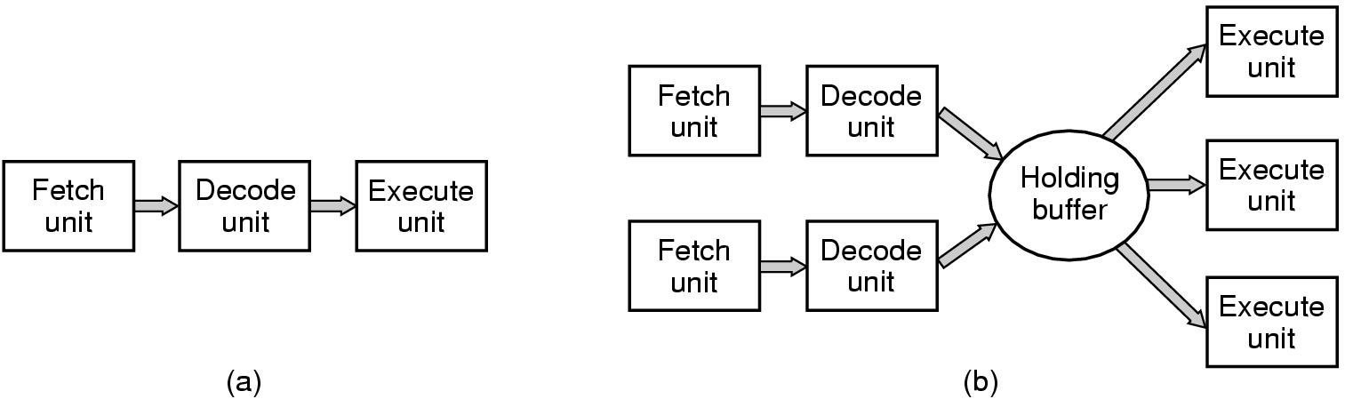
Computer Hardware Review The CPU (3)
(a) A three-stage pipeline
(b) A superscalar CPU

Slide 34
Computer Hardware Review The CPU (4)
Dual-mode operation allows OS to protect itself and other system components
User mode and kernel mode
Mode bit provided by hardware
Provides ability to distinguish when system is running user code or kernel code
Some instructions designated as privileged, only executable in kernel mode
System call changes mode to kernel, return from call resets it to user

Slide 35
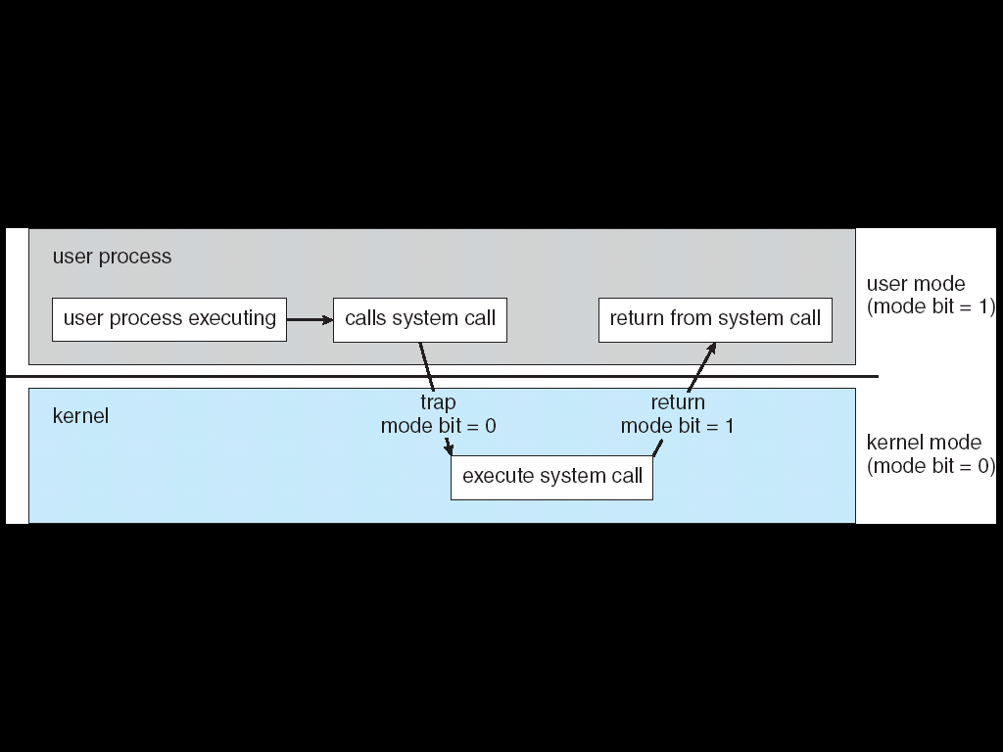
Computer Hardware Review The CPU (5)
Transition from User to Kernel Mode

Slide 36
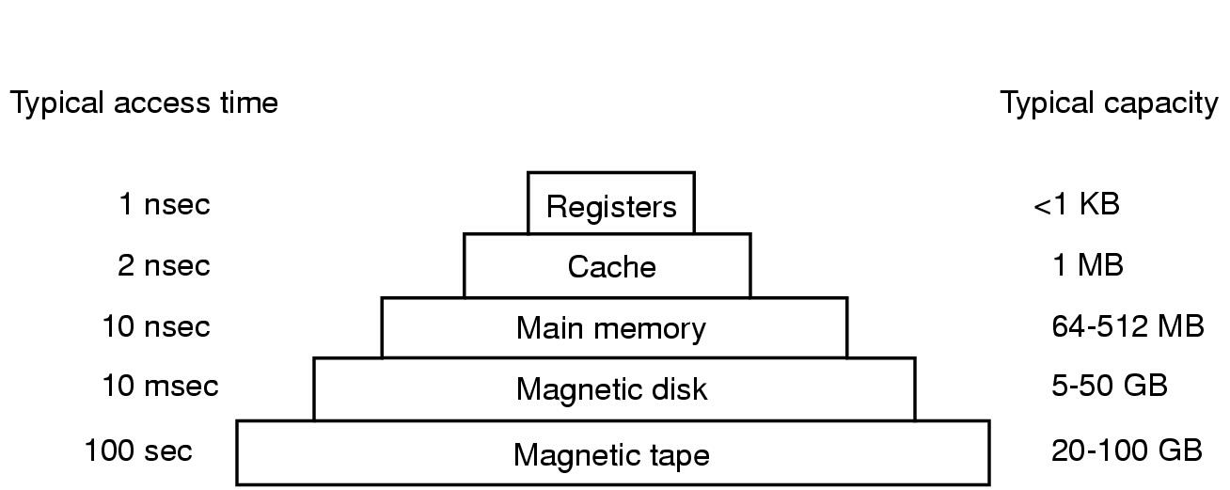
Computer Hardware Review Memory (1)
Typical memory hierarchy
numbers shown are rough approximations

Slide 37
Computer Hardware Review Memory (2)
Storage systems organized in hierarchy.
Speed
Cost
Size
Volatility

Slide 38
Computer Hardware Review Memory (3)
Registers:
Small number, Fast
Capacity:
32*32 bit on 32-bit CPU
64*64 bit on 64-bit CPU

Slide 39
Computer Hardware Review Memory (4)
Caching – copying information into faster storage system; main memory can be viewed as a last cache for secondary storage.

Slide 40
Computer Hardware Review Memory (5)
Caching
Important principle, performed at many levels in a computer (in hardware, operating system, software)
Information in use copied from slower to faster storage temporarily
Faster storage (cache) checked first to determine if information is there
If it is, information used directly from the cache (fast)
If not, data copied to cache and used there
Cache smaller than storage being cached
Cache management important design problem
Cache size and replacement policy

Slide 41
Computer Hardware Review Memory (6)
Main Memory
RAM (Random Access Memory)
Problem:
How protect the program from one another and the kernel from them all
How to handle relocation
Solution: CPU equipped with two special registers
Base Register and Limit Register
MMU (Memory Management Unit) convert Virtual Address to Physical Address
Context Switch; switching from one to another

Slide 42
Computer Hardware Review Memory (7)
Relocation and Protection
Cannot be sure where program will be loaded in memory
address locations of variables, code routines cannot be absolute
must keep a program out of other processes’ partitions
Use base and limit values
address locations added to base value to map to physical addr
address locations larger than limit value is an error

Slide 43
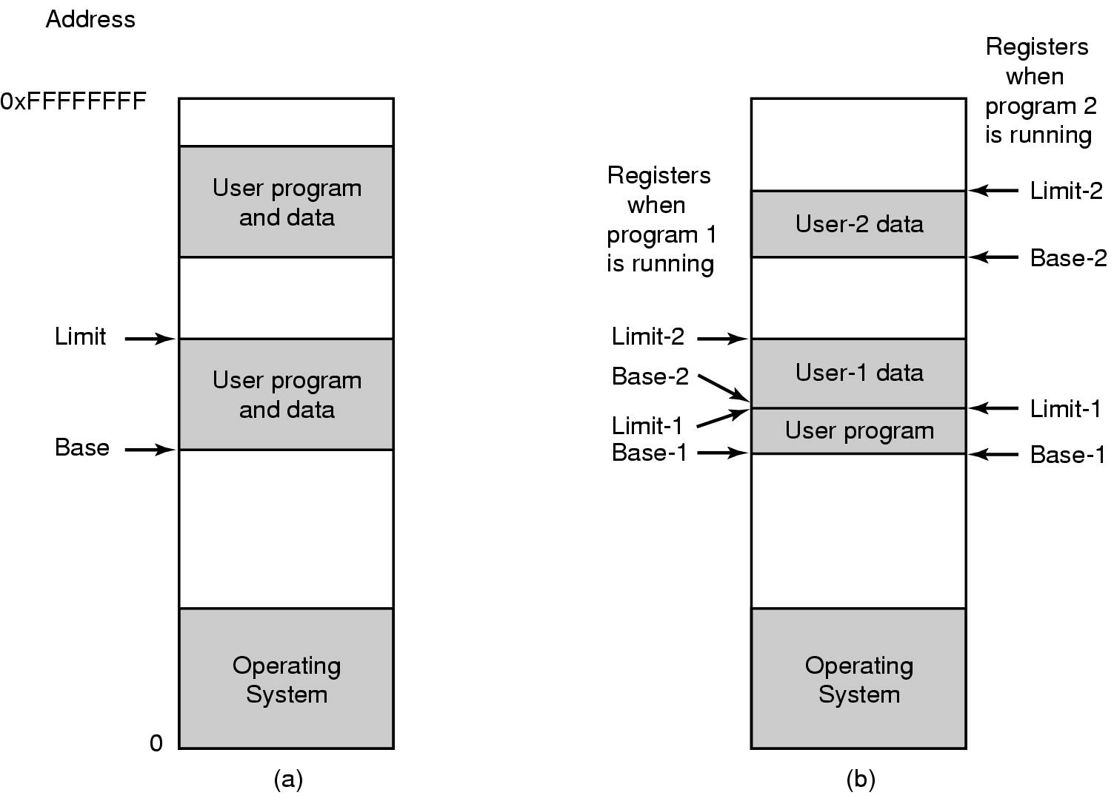
Computer Hardware Review Memory (8)
One base-limit pair and two base-limit pairs

Slide 44
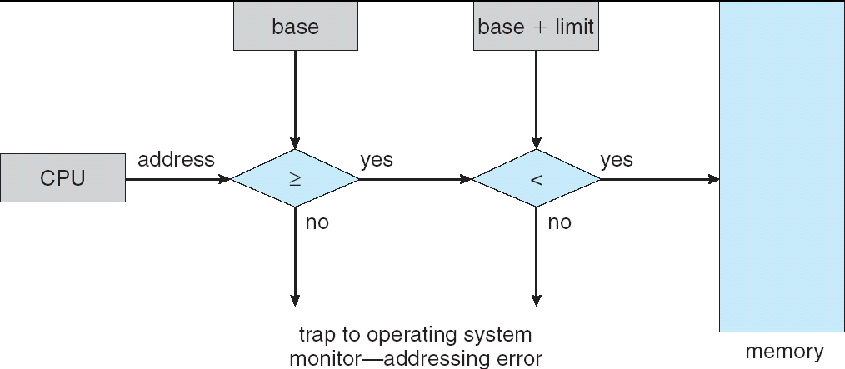
Computer Hardware Review Memory (9)

Slide 45
Computer Hardware Review Memory (10)
Other memory in computer
ROM (Read Only Memory)
EEPROM (Electrically Erasable ROM):
BIOS Basic Input Output System
CMOS:
Real time clock
Configuration Information

Slide 46
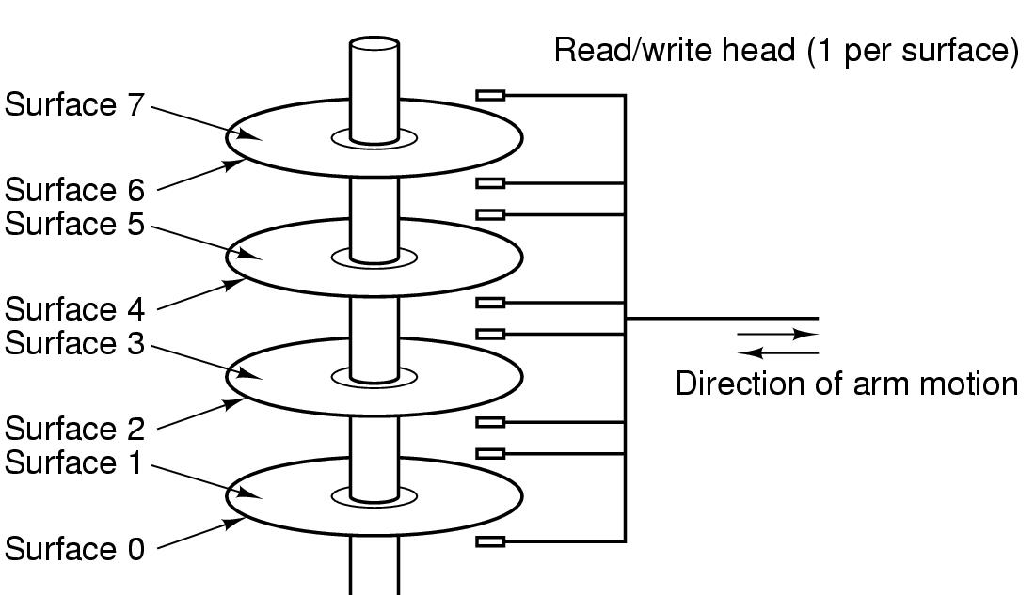
Computer Hardware Review Memory (11)
Structure of a disk drive

Slide 47
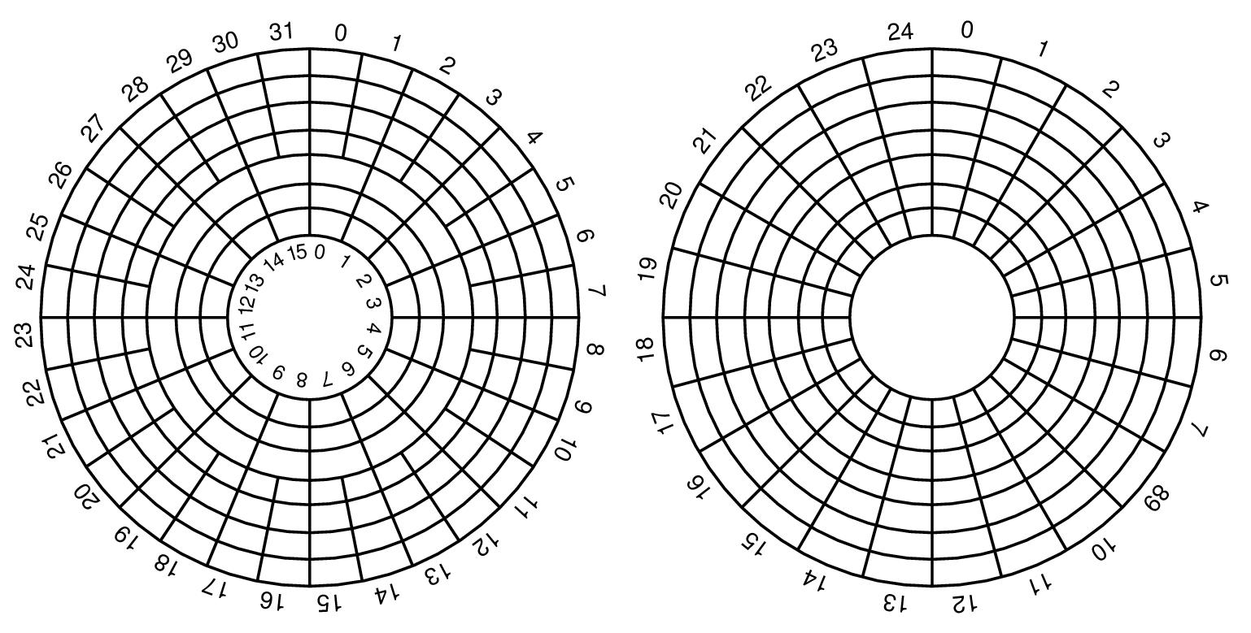
Computer Hardware Review Memory (12)
Disk: Cylinder, Track, sector

Slide 48
Computer Hardware Review I/O Devices (1)
Computer-System Operation
I/O devices and the CPU can execute concurrently.
Each device controller is in charge of a particular device type.
Each device controller has a local buffer.
CPU moves data from/to main memory to/from local buffers
I/O is from the device to local buffer of controller.
Device controller informs CPU that it has finished its operation by causing an interrupt.

Slide 49
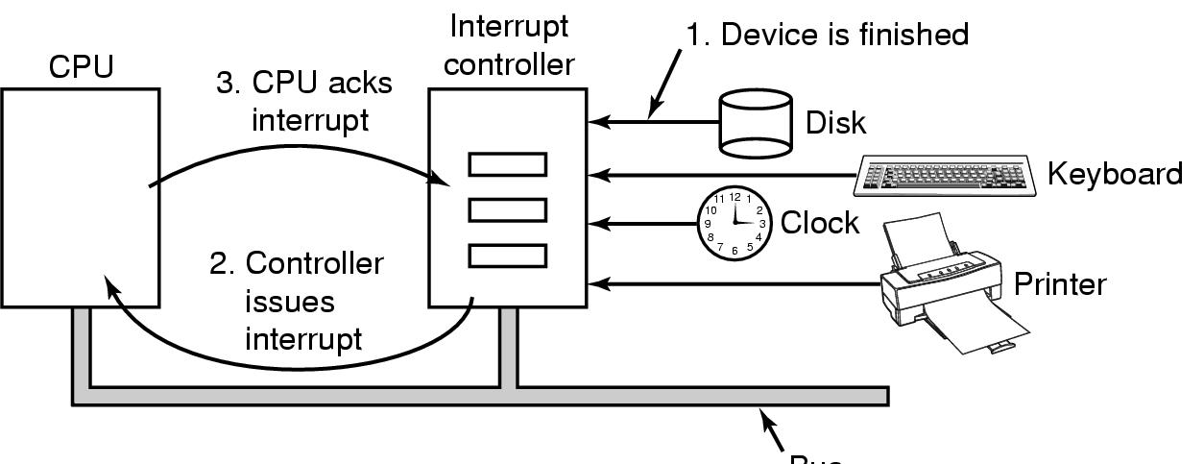
Computer Hardware Review I/O Devices (2)
How interrupts happens. Connections between devices and interrupt controller actually use interrupt lines on the bus rather than dedicated wires

Slide 50
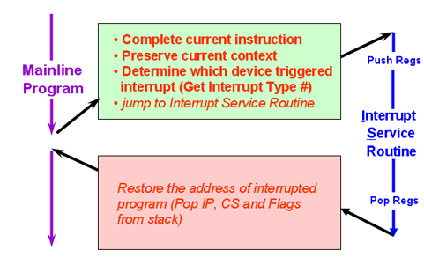
Computer Hardware Review I/O Devices (3)
Example of Interrupt processing for PC

Slide 51
Computer Hardware Review I/O Devices (3)
Common Functions of Interrupts
Interrupt transfers control to the interrupt service routine generally, through the interrupt vector table, which contains the addresses of all the service routines.
Interrupt architecture must save the address of the interrupted instruction.
Incoming interrupts are disabled while another interrupt is being processed to prevent a lost interrupt.
A trap is a software-generated interrupt caused either by an error or a user request.
An operating system is interrupt driven.

Slide 52
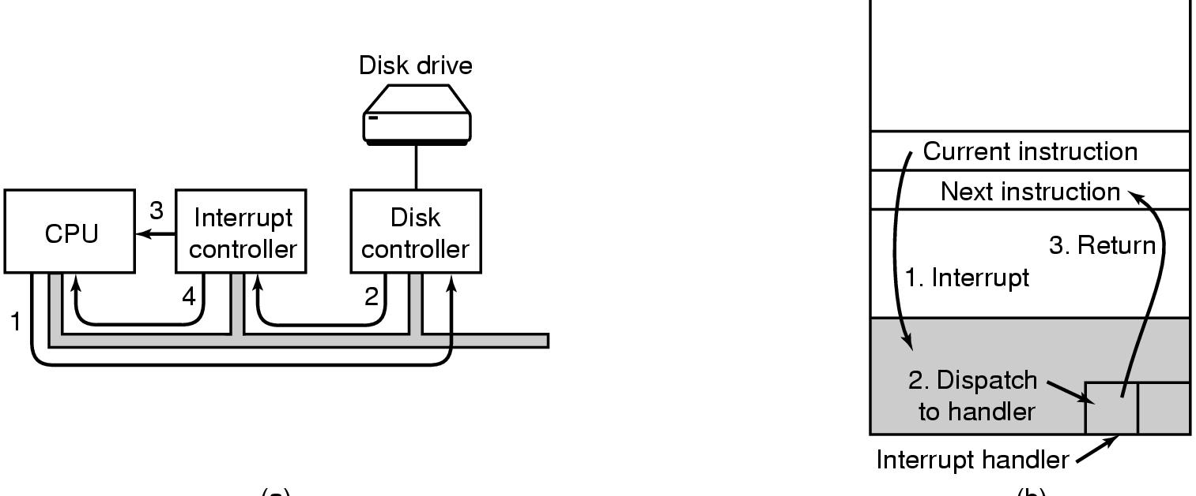
Computer Hardware Review I/O Devices (4)
(a)
(b)
(a) Steps in starting an I/O device and getting interrupt
(b) How the CPU is interrupted

Slide 53
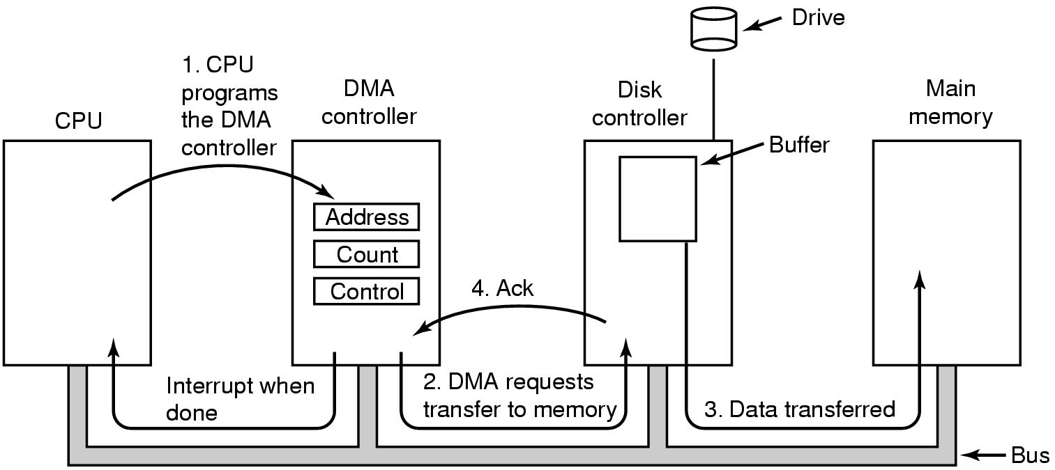
Computer Hardware Review I/O Devices (6)
Operation of a DMA transfer
DMA (Direct Memory Access)

Slide 54
Computer Hardware Review I/O Devices (7)
DMA
Used for high-speed I/O devices able to transmit information at close to memory speeds.
Device controller transfers blocks of data from buffer storage directly to main memory without CPU intervention.
Only one interrupt is generated per block, rather than the one interrupt per byte.

Slide 55
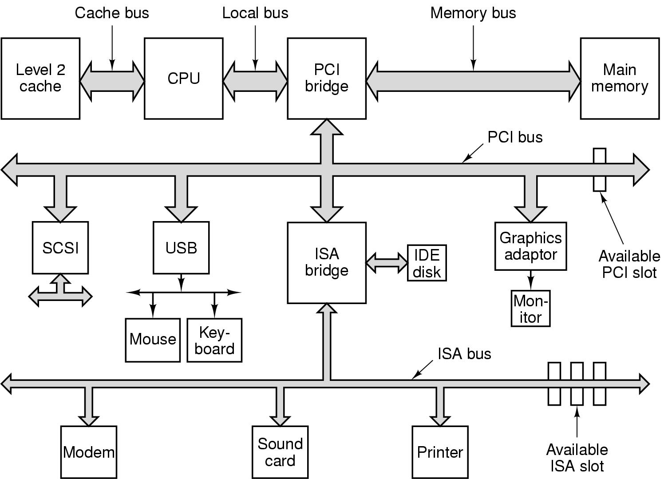
Computer Hardware Review
Structure of a large Pentium system

Slide 56
Computer Hardware Review BUS
Cache BUS
Local BUS
System BUS
ISA Industry Standard Architecture
PCI Peripheral Component Interconnect
USB Universal Serial BUS
SCSI Small Computer System Interface
IDE Integrated Drive Electronic

Slide 57
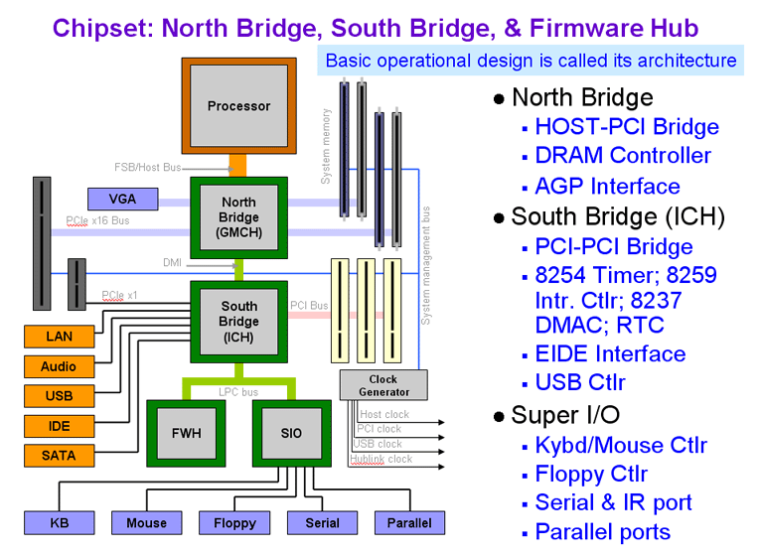
Computer Hardware Review Personal Computer (PC)

Slide 58
1.3 Operating System Concepts
OS Components
System calls
Operating system structure

Slide 59
OS Components
Process Management
Main Memory Management
File management
I/O Management
Secondary Storage Management
Protection and Security

Slide 60
Operating System Concepts OS Components (1)
Process Management
Process is a Program in execution
A process needs certain resources, including CPU time, memory, files, and I/O devices, to accomplish its task.
Tasks of process management of OS:
Process creation and deletion.
process suspension and resume
Provision of mechanisms for:
- Process synchronization
- Interprocess communication
- Prevent or avoid deadlock

Slide 61
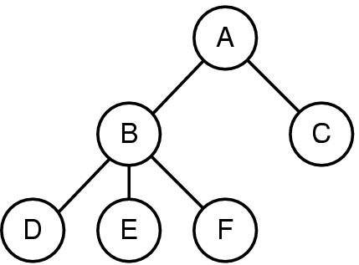
Operating System Concepts OS Components (2)
A process tree
A created two child processes, B and C
B created three child processes, D, E, and F

Slide 62
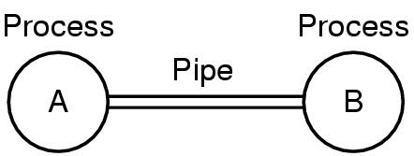
Operating System Concepts OS Components (3)
Two processes connected by a pipe

Slide 63
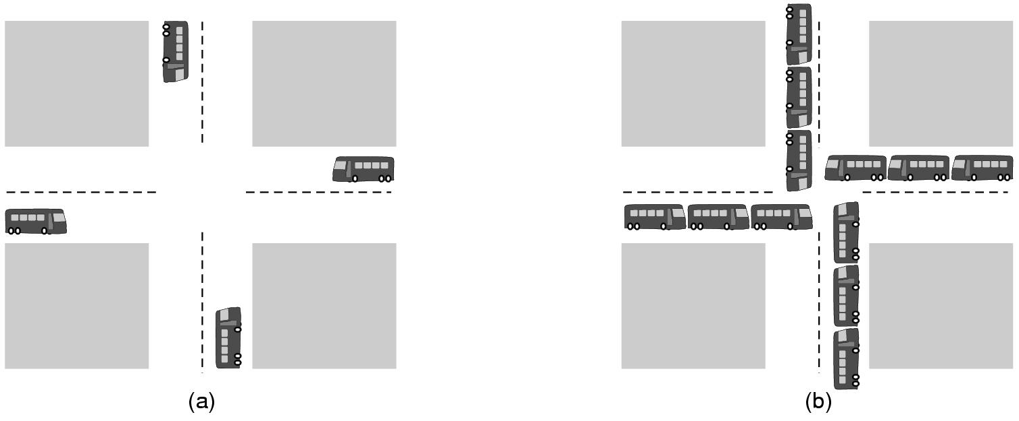
Operating System Concepts OS Components (4)
(a) A potential deadlock. (b) an actual deadlock.

Slide 64
Operating System Concepts OS Components (5)
The Deadlock Problem
A set of blocked processes each holding a resource and waiting to acquire a resource held by another process in the set.
Example
System has 2 disk drives.
P₁ and P₂ each hold one disk drive and each needs another one.

Slide 65
Operating System Concepts OS Components (6)
Main Memory Management:
Motivations:
Increase system performance
Maximize memory utilization
Task of main memory of management:
Keep track of which parts of memory are currently being used and by whom.
Decide which processes to load when memory space becomes available.
Allocate and deallocate memory space as needed

Slide 66
Operating System Concepts OS Components (7)
File management
File system
File
Directory
Task of file management of OS:
Create and delete File/Dicrectory
Manipulate: rename, copy, move, new,…
Mapping files onto secondary storage.
File backup on stable (nonvolatile) storage media

Slide 67
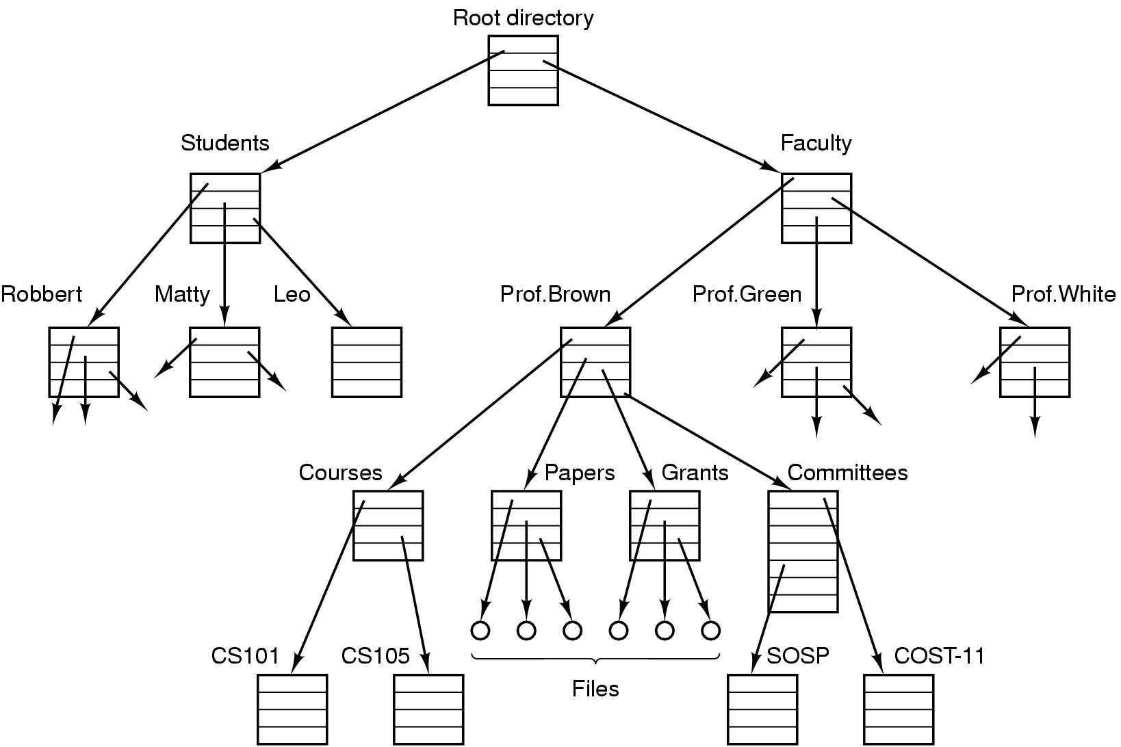
Operating System Concepts OS Components (8)
File system for a university department

Slide 68
Operating System Concepts OS Components (9)
I/O Management
Hide the specialty of H/W devices
Task of I/O Management of OS:
Manage main memory for the devices using caching, buffering, and spooling
Maintain and provide a general device-driver interfaces
Drivers for specific hardware devices.

Slide 69
Operating System Concepts OS Components (10)
Secondary Storage Management:
Since main memory (primary storage) is volatile and too small to accommodate all data and programs permanently, the computer system must provide secondary storage to back up main memory.
Common secondary storage devices: Magnetic disk and Optical disk
Task of Secondary Storage Management of OS:
Free space management
Storage allocation
Disk scheduling

Slide 70
Operating System Concepts OS Components (11)
Protection and Security
Protection – any mechanism for controlling access of processes or users to resources defined by the OS
Security – defense of the system against internal and external attacks
Huge range, including denial-of-service, worms, viruses, identity theft, theft of service

Slide 71
Operating System Concepts OS Components (12)
Protection and Security
Systems generally first distinguish among users, to determine who can do what
User identities (user IDs, security IDs) include name and associated number, one per user
User ID then associated with all files, processes of that user to determine access control
Group identifier (group ID) allows set of users to be defined and controls managed, then also associated with each process, file
Privilege escalation allows user to change to effective ID with more rights

Slide 72
Operating System Concepts Operating System Services
One set of operating-system services provides functions that are helpful to the user:
User interface - Almost all operating systems have a user interface (UI)
Varies between Command-Line (CLI), Graphics User Interface (GUI)
Program execution - The system must be able to load a program into memory and to run that program, end execution, either normally or abnormally (indicating error)
Control access to I/O device.
File-system manipulation

Slide 73
Operating System Concepts Operating System Services
Communications – Processes may exchange information, on the same computer or between computers over a network
Error detection – OS needs to be constantly aware of possible errors
….

Slide 74
System Calls
Making System Calls
Major POSIX System Calls
Examples of System Calls

Slide 75
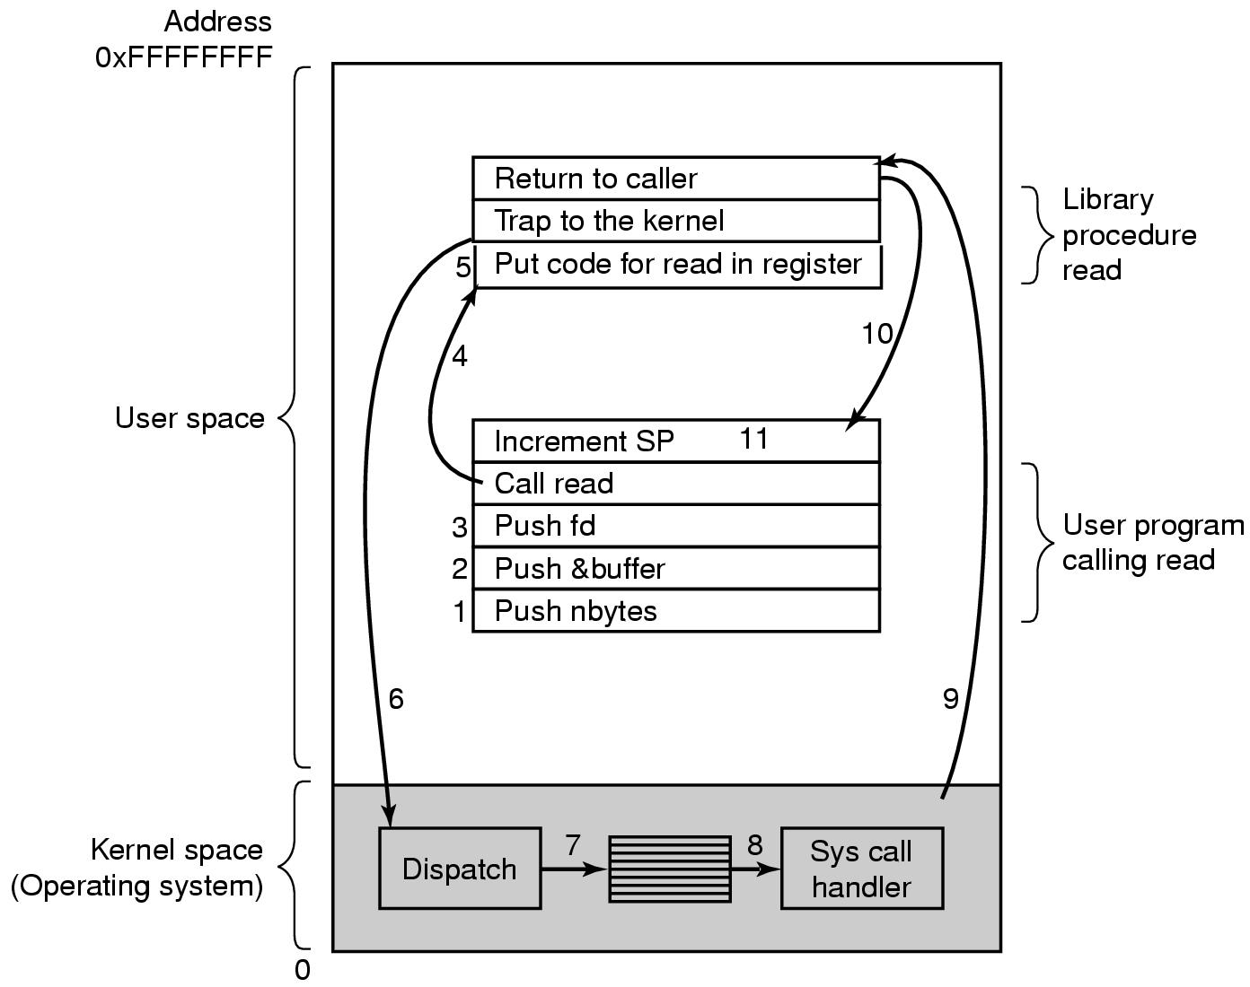
System Calls Making System Calls (1)
There are 11 steps in making the system call
read (fd, buffer, nbytes)

Slide 76
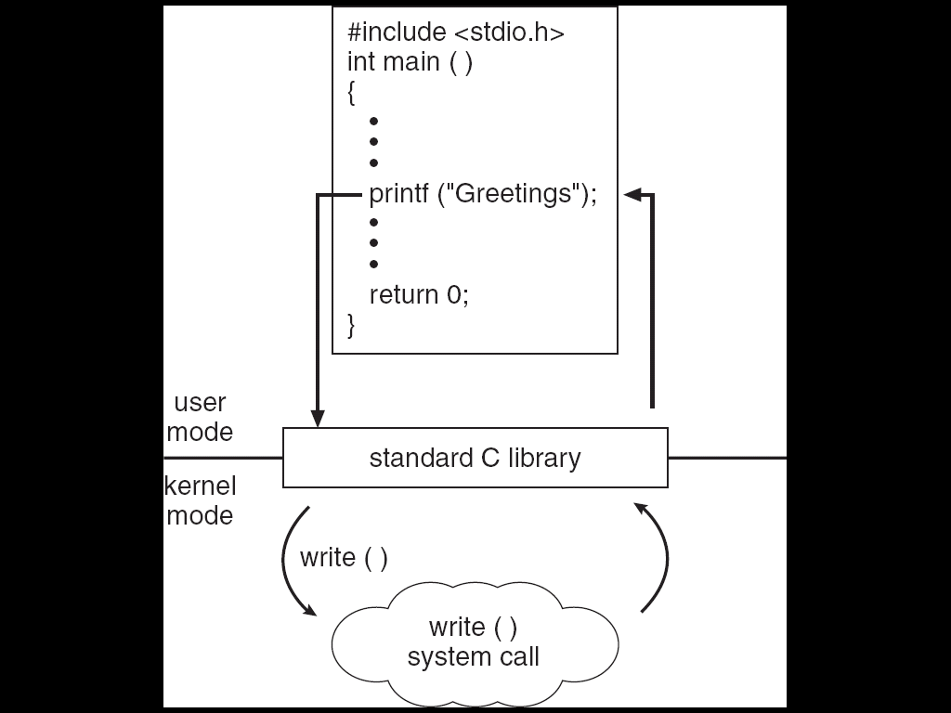
System Calls Making System Calls (2)
C program invoking printf() library call, which calls write() system call

Slide 77
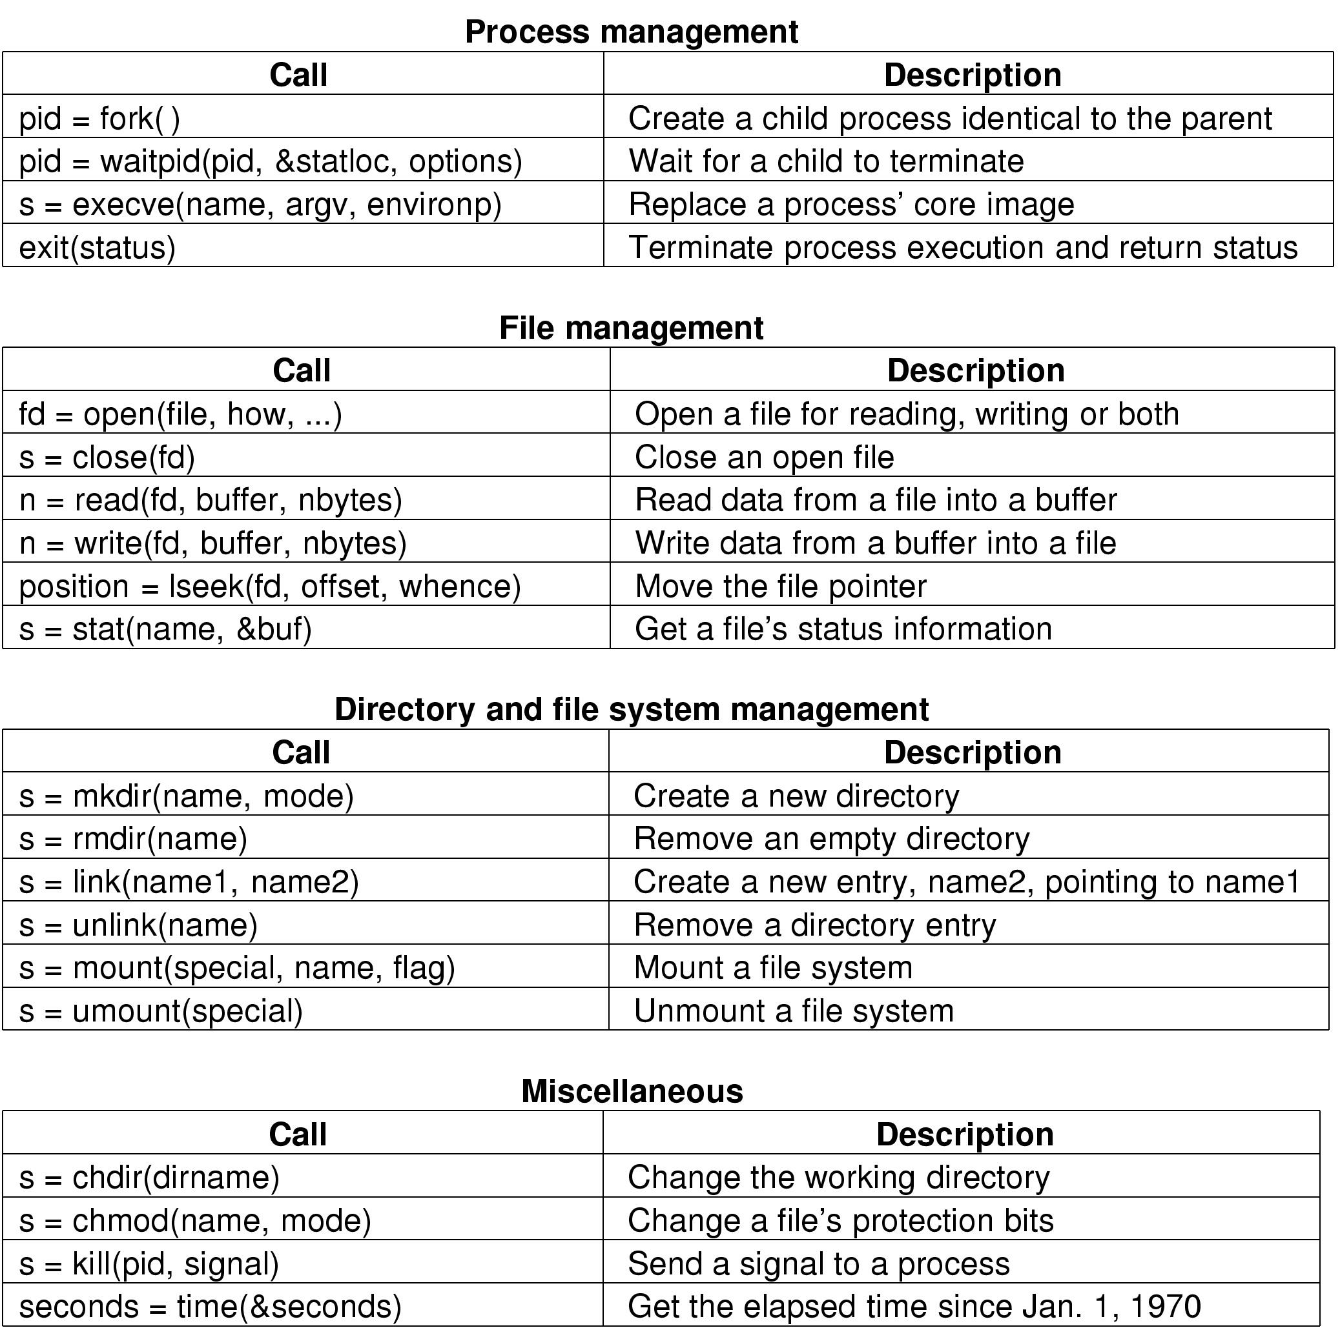
System Calls POSIX System Calls (1)
Some System Calls For Process Management
POSIX (Portable Operating System Interface)

Slide 78
System Calls POSIX System Calls (2)
Some System Calls For File Management

Slide 79
System Calls POSIX System Calls (3)
Some System Calls For Directory Management

Slide 80
System Calls POSIX System Calls (4)
Some System Calls For Miscellaneous Tasks

Slide 81
System Calls Examples (1)
A stripped down shell:
while (TRUE) { /* repeat forever */
type_prompt( ); /* display prompt */
read_command (command, parameters) /* input from terminal */
if (fork() != 0) { /* fork off child process */
/* Parent code */
waitpid( -1, &status, 0); /* wait for child to exit */
} else {
/* Child code */
execve (command, parameters, 0); /* execute command */
}
}

Slide 82
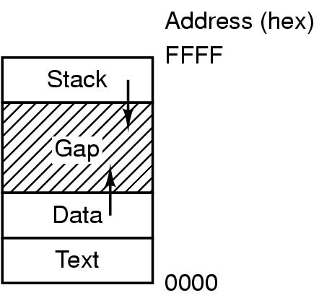
System Calls Examples (2)
Processes have three segments: text, data, stack

Slide 83
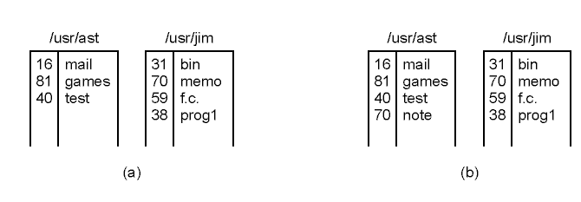
System Calls Examples (3)
(a) Two directories before linking /usr/jim/memo to ast's directory
(b) The same directories after linking

Slide 84
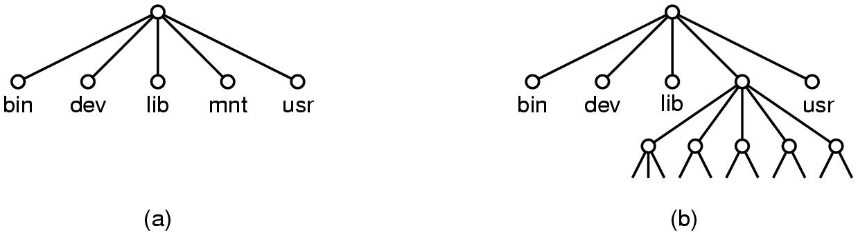
System Calls Examples (4)
(a) File system before the mount
(b) File system after the mount

Slide 85
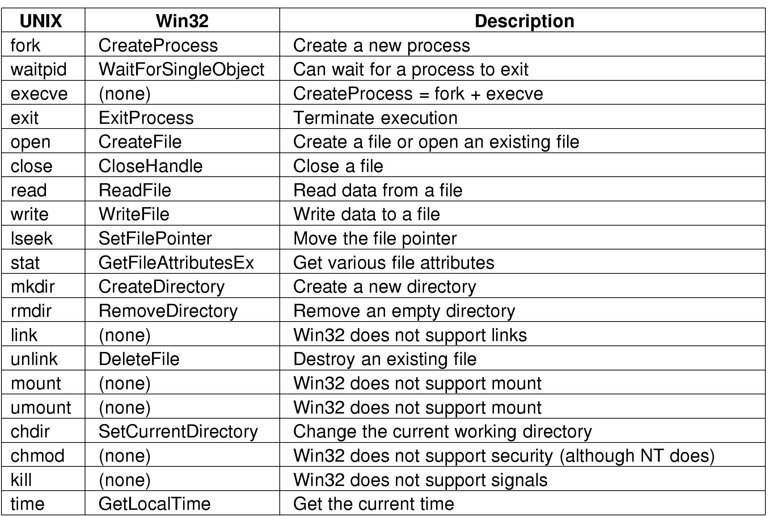
System Calls
Some Win32 API calls

Slide 86
Operating System Structure
Monolithic system
Layered System
Virtual Machine
Client-server model
Microkernel

Slide 87
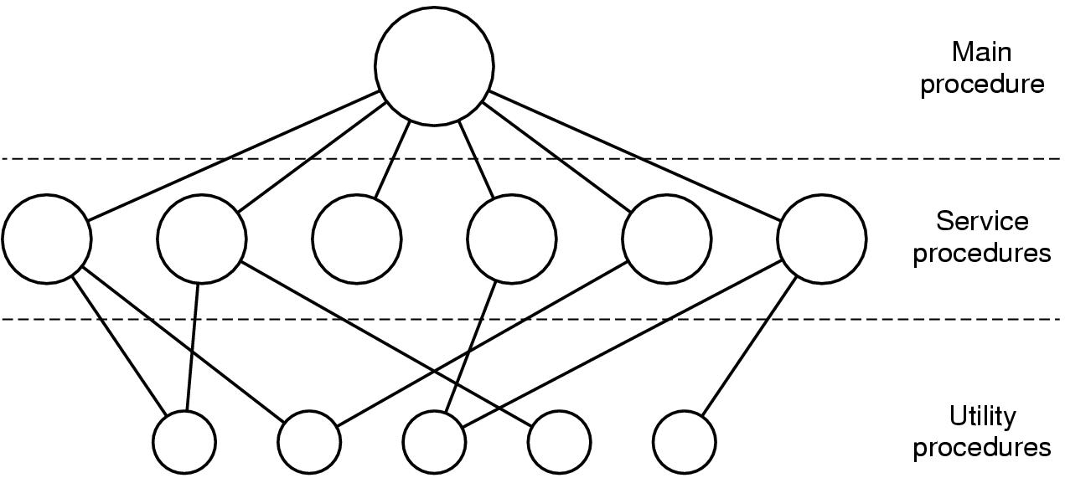
Operating System Structure Monolithic system (1)
Simple structuring model for a monolithic system

Slide 88
Operating System Structure Monolithic system (2)
Structure of Operating System:
A main program that invokes the requested service procedure.
A set of service procedures that carry out the system calls.
A set of utility procedures that help the service procedures.

Slide 89
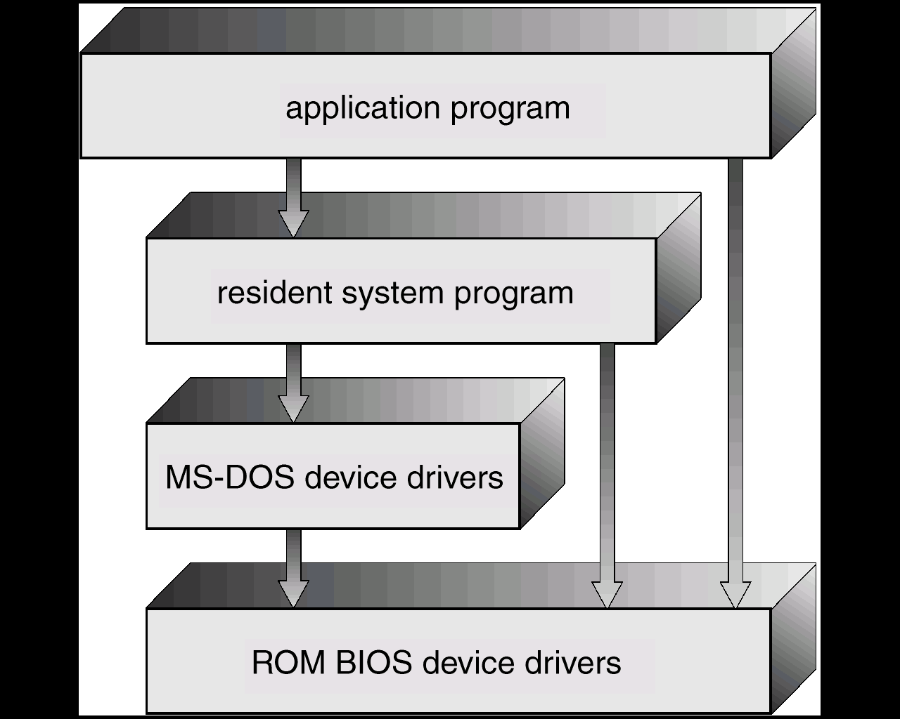
Operating System Structure Monolithic system (3) : Example
Monolithic
MS-DOS – written to provide the most functionality in the least space:
not divided into modules;
Although MS-DOS has some structure, its interfaces and levels of functionality are not well separated

Slide 90
Operating System Structure Layered System (1)
Many Layers
Each layer has well defined functions
Upper layer can only calls functions of closely lower layer
Advantages:
Easier to extend
Easier to debug from lower to upper layer

Slide 91
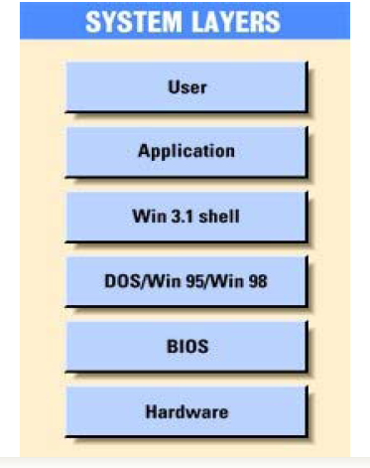
Operating System Structure Layered System (2): Example

Slide 92
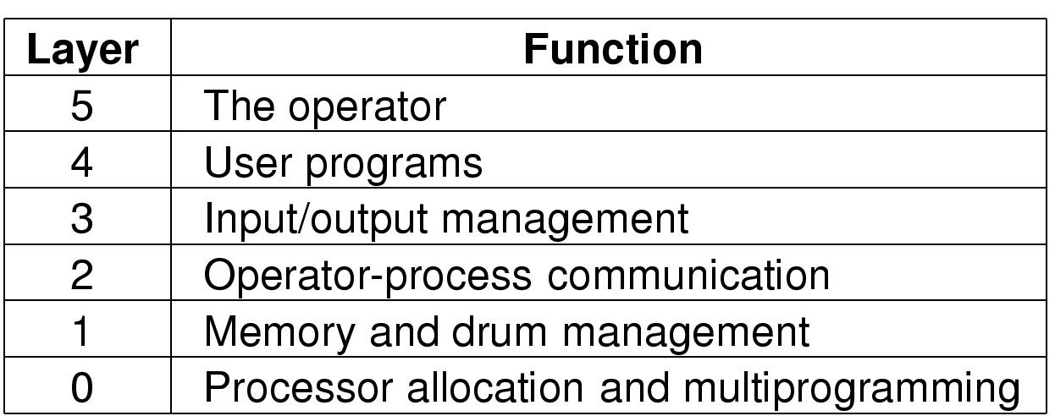
Operating System Structure Layered System (3): Example
Structure of the THE operating system

Slide 93
Operating System Structure Virtual Machine (1)
processes
kernel
hardware
processes | processes | processes
kernel | kernel | kernel
VM1 | VM2 | VM3
Virtual-machine implementation
hardware
programming
interface
Non-virtual machine system model
Virtual machine system model

Slide 94
Operating System Structure Virtual Machine (2)
A virtual machine takes the layered approach to its logical conclusion. It treats hardware and the operating system kernel as though they were all hardware
A virtual machine provides an interface identical to the underlying bare hardware
The operating system creates the illusion of multiple processes, each executing on its own processor with its own (virtual) memory

Slide 95
Operating System Structure Virtual Machine (3)
The resources of the physical computer are shared to create the virtual machines
CPU scheduling can create the appearance that users have their own processor
Spooling and a file system can provide virtual card readers and virtual line printers
A normal user time-sharing terminal serves as the virtual machine operator’s console

Slide 96
Operating System Structure Client-server model (1)
The client-server model

Slide 97
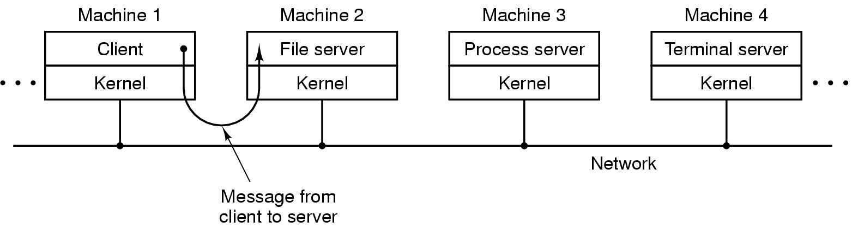
Operating System Structure Client-server model (2)
The client-server model in a distributed system

Slide 98
Operating System Structure Microkernel: Example
Microkernel
OS design: The operating system is divided into microkernel (CMU Mach OS - 1980)
Moves as much from the kernel into “user” space
kernel → microkernel
Communication takes place between user modules using message passing.
Application
POSIX
application
X-application
File
server
POSIX
server
X-window
server

Slide 99
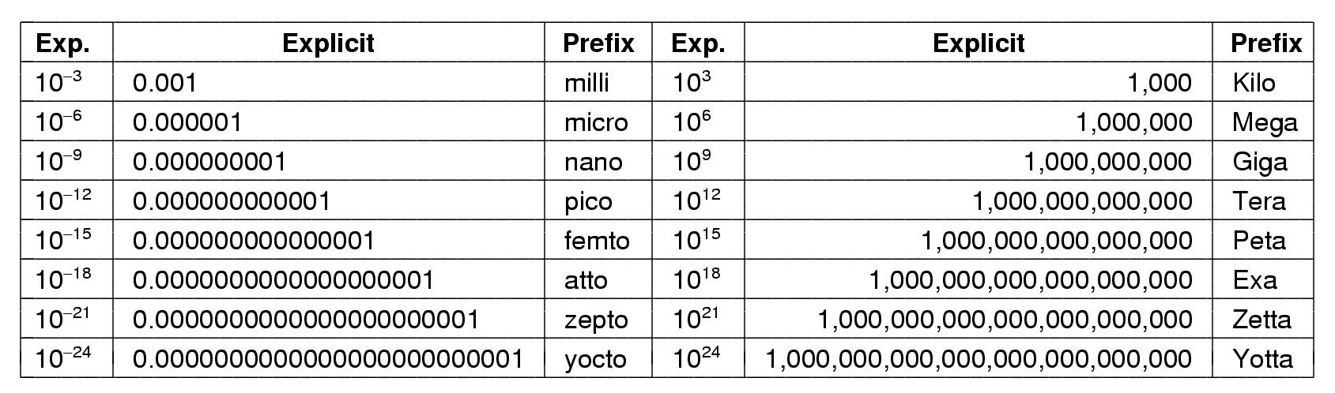
Metric Units
The metric prefixes

